Slide 1
Status report for the 101 project
Babak Hosseini 30/09/2019
1

Slide 2
Classification task/objective:
Determining the priority of a failed check based on :
Check type
Device name
Device type (server / workstation)
Failure detail
Failure trajectory
….
01.05.2019
Master-Vorlage 2019
Seite 1

Slide 3
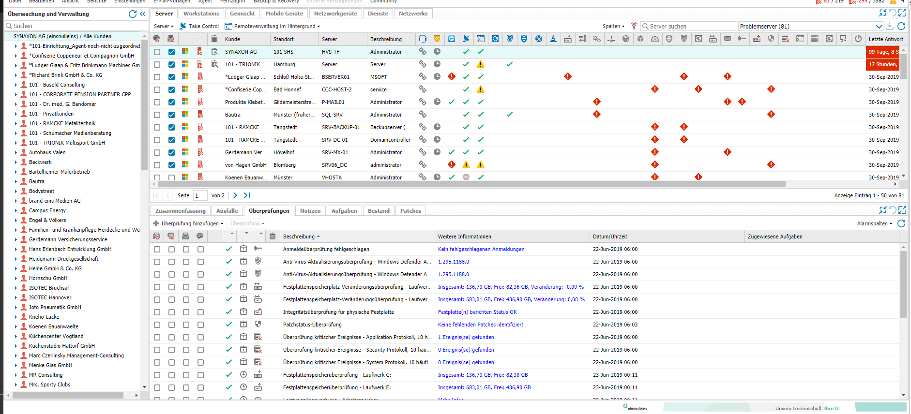

Slide 4
Classification task/objective:
Determining the priority of a failed check based on :
API call → checks status → Priority of the fails → update dashboard
30.09.2019
Master-Vorlage 2019
Seite <number>

Slide 5
Data resources:
RedMineDB:
Issued tickets related to the past problems
Data is annotated!
!! No direct connection to SolarWinds (mostly)
Mostly created based on the customer calls
Difficult to related to a check in SWs
!! Not all the required detail is always imported
e.g., device name, device type, Priority
01.05.2019
Master-Vorlage 2019
Seite <number>

Slide 6
Data resources:
MongoDB:
Record of the past performed checks in SolarWinds (background)
Based on API Calls from SolarWinds → similar to the recall phase
01.05.2019
Master-Vorlage 2019
Seite <number>

Slide 7
Data resources:
MongoDB:
Record of the past performed checks in SolarWinds (background)
Based on API Calls from SolarWinds → similar to the recall phase
!! Data is not annotated!
!! Large sample time (3 hours)
!! Many of the recorded rows are not necessary!
Passed checks / redundant repetitions
!! Not all the details are clear to the experts
E.g. checkstatus (add, testcleared, testokinactive, etc)
01.05.2019
Master-Vorlage 2019
Seite <number>

Slide 8
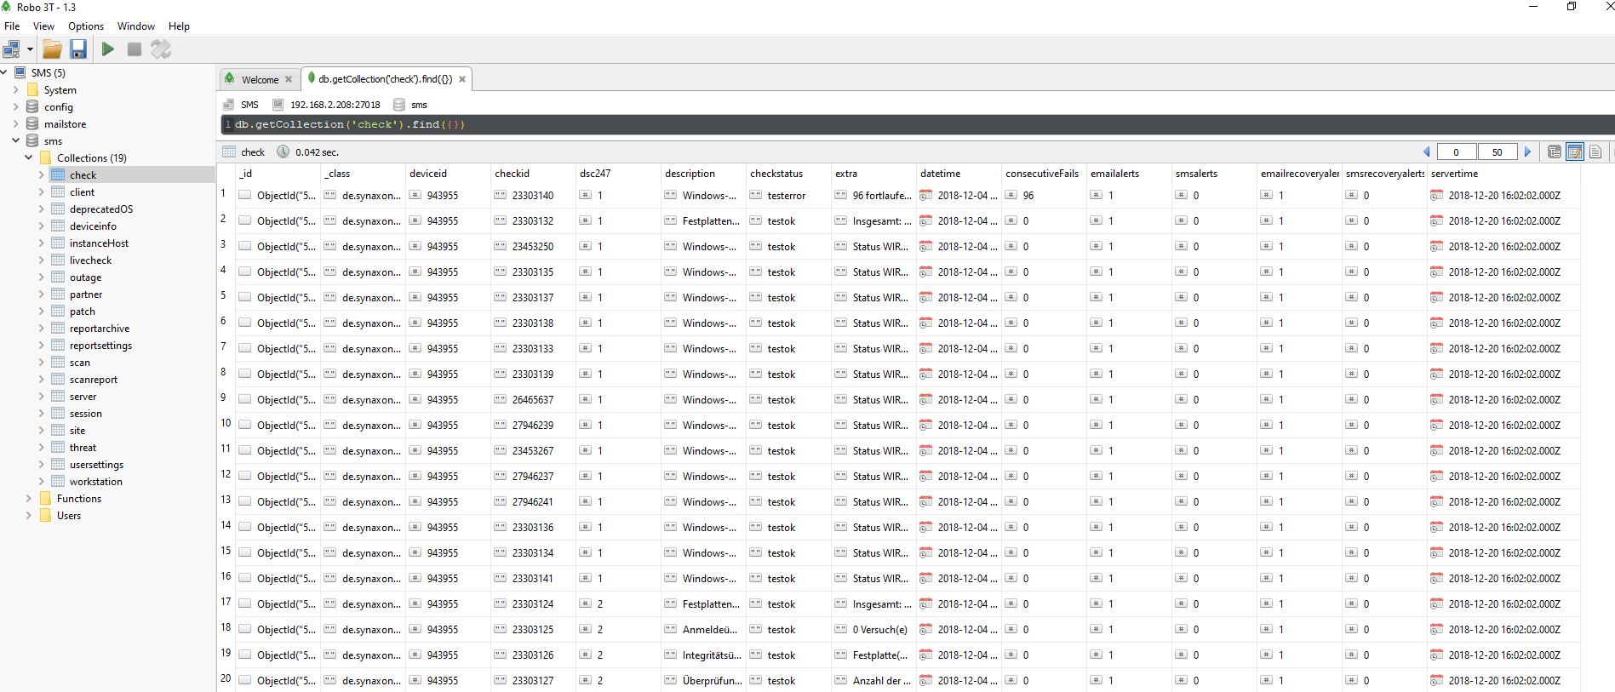

Slide 9
Annotation task:
Labeling the failed checks in MongoDB:
Categories (labels):
High priority failure
Normal priority failure
False alarms
Not enough info is provide
Monitoring the failure progress
01.05.2019
Master-Vorlage 2019
Seite <number>

Slide 10
Annotation task:
!! Huge amount of data samples (8M failed checks per month)
Sticking the sequential failure-status together
Reducing from 16M to 5K
Not efficient to do large-scale annotation in a single-run
Possibility of going wrong esp. at the beginning
First run: labeling 2 month → google sheet
01.05.2019
Master-Vorlage 2019
Seite <number>

Slide 11
Classification-annotation scheme:
Determining the priority of a failed check:
Based on MongoDB records
Needs to label the MongoDB data
A back-and-forth procedure between annotation/classification/data acquisition
E.g. Annotation A → train classifier → correct annotation A → re-train classifier
→ Annotation B → modify/re-train/extend classifier
→ re-annotate A
01.05.2019
Master-Vorlage 2019
Seite <number>

Slide 12
Hybrid classification model:
Unbalanced classes
Small H-priority samples compared to other classes
Sparse data samples
Per type of check (esp. failed cases)
Dis-continues data distribution
Non-numerical features (most cases)
01.05.2019
Master-Vorlage 2019
Seite <number>

Slide 13
Hybrid classification model:
Checks with priority independent from device or etc.
Hand coded during the annotation phase
Recognized by their constant label in training
e.g. Skriptüberprüfung - Terra Backup → always a critical failure
e.g. Leistungsüberwachung – Prozessorwarteschlange → always can be ignored
e.g. Anti-Virus-Aktualisierungsüberprüfung - Managed Antivirus → cannot be a critical failure ever
01.05.2019
Master-Vorlage 2019
Seite <number>

Slide 14
Hybrid classification model:
Checks with priority independent from device or etc.
Hand coded during the annotation phase
Recognized by their constant label in training
Checks with priority chosen based on device, extra info, sub-category, etc.
Learned by decision tree
A beforehand feature extraction part
e.g. Festplattenspeicherüberprüfung – Laufwerk → extra info: Frei / Total < 20% → High priority
e.g. PING-Überprüfung – XXX → depends on the device ID XXX
e.g. general pattern of YYY-XXX → classified based on YYY and XXX and other features
01.05.2019
Master-Vorlage 2019
Seite <number>

Slide 15
Classification Result:
Training: 2 months of checks
Test: 1 month check data
Categories: High priority and non-High priority
Accuracy:
Class H: 98.4%
Class nH: 97.4%
new annotation strategy in favor of class H
 | Class nH | Class H
categorized as nH | 2593 | 69
categorized as H | 7 | 432
01.05.2019
Master-Vorlage 2019
Seite <number>

Slide 16
Classification Result:
Training: 2 months of checks
Test: 1 month check data
Categories: High priority (H), normal priority (N), false alarm (F)
Accuracy:
Class H: 98.4 %
Class N: 94.6%
Class F: 77.3 %
Hand-coded rules which
do not consider false-positives
 | Class N | Class H | Class F
categorized as N | 968 | 52 | 3
categorized as H | 7 | 432 | 0
categorized as F | 355 | 17 | 1267
01.05.2019
Master-Vorlage 2019
Seite <number>

Slide 17
Classification Issues:
Change in the annotation scheme:
New types of check
New sub-categories of checks
01.05.2019
Master-Vorlage 2019
Seite <number>

Slide 18
Approaching the Issues:
Change in the annotation scheme:
Finding new rules → apply to the old annotation
Manual re-annotation
New types of check
Training (or hand-coding) a classifier on the data
New sub-categories of checks:
Re-train the classifier / adding more rules
01.05.2019
Master-Vorlage 2019
Seite <number>

Slide 19
Next phase(s):
Improving the classifier on 1-2 more months of data
Implementing code of API based predictor
SolarWinds API call → check label
Evaluation by 101-team
In-parallel to their own dashboard
Consider it as priority suggestions
Mark the write/wrong prediction (at least for class-H cases)
01.05.2019
Master-Vorlage 2019
Seite <number>

Slide 20
Long-term Plan:
Active learning scheme:
Improve the classifier by new annotations / errors
More data → more complicated models
Temporal analysis of failures
Deep learning frameworks
01.05.2019
Master-Vorlage 2019
Seite <number>

Slide 21
Improvements in the database systems:
Connection between RedMine & MongoDB:
More dedication in importing ticket details
e.g., device name, server/workstation and etc
Relating each ticket to a possible check in SolarWinds
Designing unique checkid for each type of check
where possible
MongoDB (recording API calls)
unique checkid for each type of check
Smarter import intervals depending on the type of check
01.05.2019
Master-Vorlage 2019
Seite <number>

